Slide 1
blueButler AI
powered by GPT

Slide 2
What Agencies are saying about blueButler:
“We broke all of our agency sales records using blueButler Voice Signatures!”
“We are seeing retention figures higher than ever! blueButler paid for itself immediately.”
"blueButler provides unmatched E&O protection for our agency's phone call processes, from start to finish."
blueButler
For Applied Epic
Automated Documentation Platform
for your VoIP / UCaaS System
integrated with Applied Epic

Slide 3
blueButler’s PREMIUM
VoIP / UCaaS Integrations
Screen Pop Applied Epic client file and policies
Automated Applied Epic Activity Note creation
MP3 Call Recordings (PCI Payment & CMS Health Benefit Compliant)
Best practice Scripts & Checklists
Searchable SQL Database Call Records & Drill-down Reports
Click-to-call* (for select VoIP systems)
NEW blueButler GPT co-pilot features:
Auto-doc Summary Notes
Call Transcriptions
Customer Sentiment Analysis

Slide 4
blueButler AI
powered by GPT
Automatically creates a Summarized Note of every client call, linked into your AMS
Transcribes the recorded call
Provides Customer Sentiment Analysis
And much more to come!

Slide 5
Summary Note
The caller is discussing insurance for their son who wants to buy a truck. They had previously called for a quote but never received a call back.
The customer is an existing client and provides the necessary information for the quote. The initial quote for insuring the son by himself is $1,749 per year.
The customer also considers adding the son to their own insurance policy but is advised that it would be the same price. The customer is given a direct line to communicate directly with the representative.
The conversation ends with the customer saying they will decide and contact the representative if they have any further questions.
GPT generated Summary Note
Actual agency phone call:
All of this unfolds seamlessly and is documented in your AMS with a single click of a button!

Slide 6
On average, insurance staff make & receive between 50 and 200 calls per month with clients and prospects (avg call length of 3 to 6 minutes) that require staff to properly document the client's instructions in their AMS system.
This tedious and time-consuming effort that often takes 3 to 10 minutes for every call, can be eliminated with the new blueButler AI co-pilot, freeing staff to focus on client needs rather than "paperwork“.
What Impacts will blueButler AI
have on Agency Operations?
GPT Summary Notes
frees up staff time by eliminating administrative tasks
150 calls/mo * 4 mins/call = 10 hours/mo
@ 20 days/month = ½ hour / day
saved to focus on servicing clients!

Slide 7
Automated Call Documentation
(Audio, Transcription, Summary, Sentiment)
00:08:13.000
So what I did is full physical coverage on the vehicle.
Okay, so terminal liability, all peril coverage at $1,000 deductible.
Loss of use coverage as well, up to $2,000.
And standard accident benefits.
Okay.
Since he never had insurance before, the only thing he doesn't qualify for is accident forgiveness.
00:08:36.000
GPT generated Call Transcription
Actual agency phone call:
Use “closed caption” style transcriptions to quickly scroll to the portion of calls of interest

Slide 8
Customer Sentiment
The customer sounds frustrated as he had called before but did not receive a call back with the quote.
However, he remains cooperative and provides the necessary information to get a new quote.
GPT generated Customer Sentiment
Actual agency phone call:
Filter calls by Sentiment for precision review and use Sentiment Analysis reports to monitor trends

Slide 9
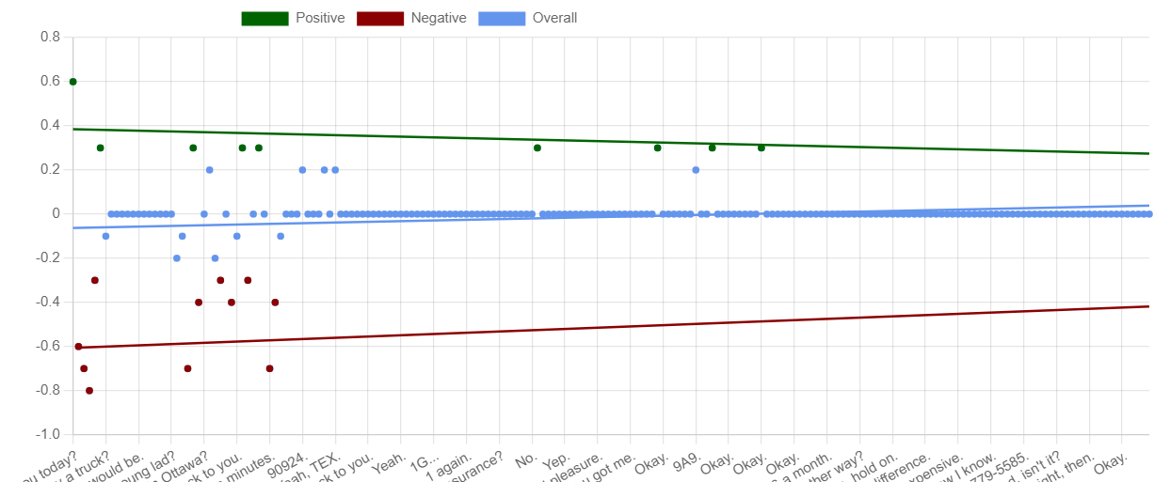
GPT generated Customer Sentiment Graph

Slide 10
Automated GPT Sentiment Analysis filters out calls where the client experience is below certain thresholds.
Saving even a small percentage of your clients and closing additional new business can have a profound impact on your agency.
What Impacts will blueButler AI
have on Agency Operations?
GPT Sentiment Analysis
identifies clients / prospects potentially at risk
Improving your agency’s retention rate immediately impacts the bottom line and closing more deals using sentiment analysis to identify prospects who require follow-up helps grow your book of business!

Slide 11
Automated GPT Transcriptions provide an easy way to search an MP3 audio file for review when required.
Transcriptions are integrated with the blueButler Automated Documentation Platform that guides best practices through Scripts & Checklists.
Voice Signature Scripts confirm client instructions.
Together they provide unprecedented E&O protection for your agency!
What Impacts will blueButler AI
have on Agency Operations?
GPT Transcriptions
stored with MP3 recordings provide original source material for every client call
E&O claims have a major impact on an agency’s business.
blueButler’s best practices avoids problems before they happen and automated documentation of original client instructions helps resolve disputes quickly.

Slide 12
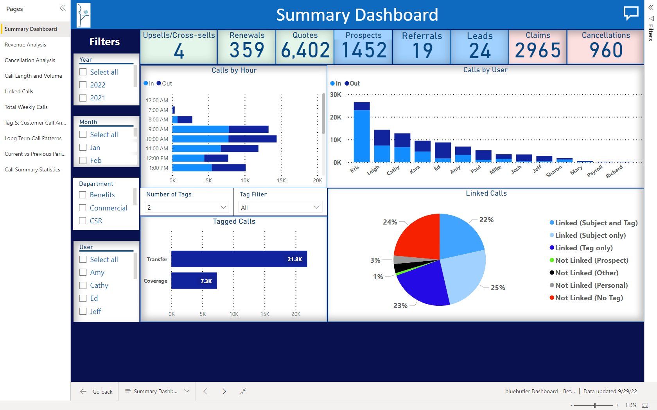
GPT-driven ANALYTICS
Analytic processes are dependent on the data sources available for analysis
Good Data = Good Outcomes
blueButler AI auto-docs original client conversations (transcriptions & summaries) of every call.
What better way to ensure that you have good information in your Data Lake for your AI models to use?

Slide 13
BETA Program
Start of BETA
Purpose: Validate the GPT-generated documentation outcomes and costs; Add additional features in parallel (such as - Automatic triggers vs Manual, Translations, Copy link (to add a hotlink to the documentation into CRM or other systems)
Focus: English only; Hosted VoIP system; 5 to 10 customers each with pilot teams of <10 users
Mid-BETA Program
Purpose: Evaluate feedback; Prioritize potential features to add for Initial Product Release
Focus: Other Languages; Additional VoIP systems; Increase the number of customers and users to evaluate overall performance
End of BETA
Purpose: Productize and release the product with final feature set and pricing; Evaluate feedback from Beta customers to prioritize feature set for Version 2
blueButler AI
BETA Test Program
The Beta test will be done in stages to validate results, test the performance as load increase, and finalize the feature list for the Production Release.

Slide 14
With blueButler, you choose the VoIP System that suits your agency!

Slide 15
With blueButler, you choose the VoIP System that suits your agency!
Our recent VoIP integrations and announcements:
We have published our open REST API to enable VoIP vendors to integrate easily with blueButler
Our first VoIP partner to utilize the API is
Two other VoIP partners are starting their integration projects
Coming soon … new UCaaS integrations for both voice and text!

Slide 16
blueButler AI
powered by GPT
FUTURE AI co-pilot possibilities
Analysis
(Topic detection; “Second set of eyes”)
Analytics
(Pipeline into a Data Lake; GPT provided best practice scripts/checklists)
Automation
(chatGPT to prompt user based on call histories; Automate processing of Payments / Consents / Voice & Text signatures)

